Slide 1

Modelu(Cam 1)
Cyd-destun dysgu’r patrymau: Dathlu
Llafaredd:Oracy
Modelu - drilio

Slide 2

Cam1 – Modelu a drilio DRILIO-GWELER Y FIDEOS AM SYNIADAU Drilling – See videos for ideas
Beth sydd angen gwneud?
Adnabod patrymau a mapio patrymau’r uned
Drilio patrymau a geirfa dros amser
Dethol a dewis yr ystod/ geirfa o batrymau yn ôl gallu’r disgblion
Iaith newydd
Ail- gylchu iaith
Ymestyn
Rhaid sicrhau bod sgiliau llafar yn cael eu hatgyfnerthu gan sgiliau gwrando , darllen ac ysgrifennu. Ni ddylid dysgu llafaredd yn ynysig.

Slide 3
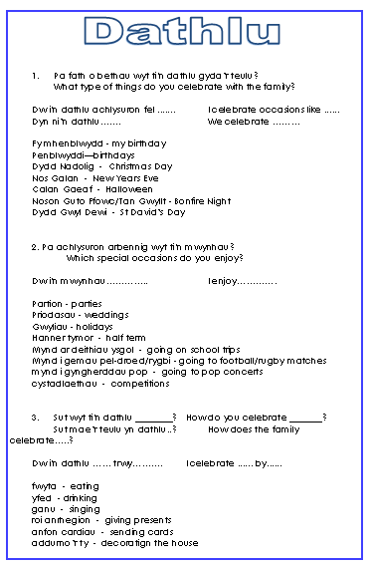
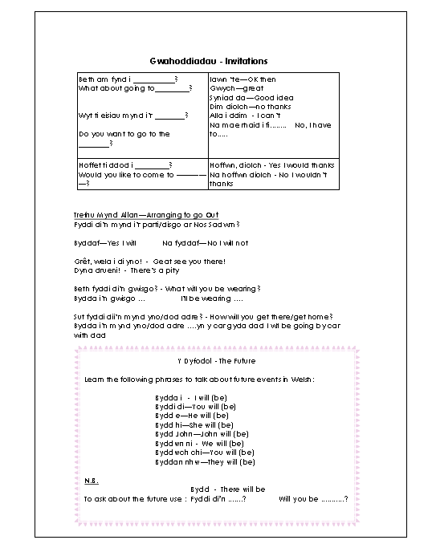
Mapio iaith ar draws yr uned:

Slide 4
Cyflwyno gwybodaeth: Y presennol: Cerdyn cymorth
Dw i’n …+ berf
hoffi / mwynhau / dwlu ar /gallu / mynd/ bwyta /yfed/dathlu /rhedeg/gwisgo
Mae ci bach brown
‘da fi
Ydy
Oes
Mae e’n / Mae hi’n…+berf
hoffi / mwynhau / dwlu ar /gallu / mynd/ bwyta /yfed/dathlu / rhedeg/gwisgo
Mae ci bach brown
‘da fe
Mae ci bach brown
‘da hi
Ydy e’n … / Ydy hi’n…+berf
hoffi / mwynhau / dwlu ar /gallu /dathlu. mynd/ bwyta /yfed /rhedeg/gwisgo?
Oes anifail anwes
‘da fe / da hi?
Nag oes
Dydy e ddim yn …/ Dydy hi ddim yn…+berf
hoffi / mwynhau / dwlu ar /gallu / mynd/ bwyta /yfed/dathlu /rhedeg/gwisgo
Does dim ci bach brown
‘da fe
Does dim ci bach brown
‘da hi
Nac Ydy

Slide 5

Enghraifft: Dathlu: Iaith Newydd
Iaith newydd
Ail- gylchu iaith
Pa fath o bethau wyt ti'n dathlu gyda’r teulu?
Ymestyn
Dw i'n dathlu achlysuron fel ....... Dyn ni’n dathlu……. Fy mhenblwydd - my birthday Penblwyddi—birthdays Dydd Nadolig - Christmas Day Nos Galan - New Years Eve Calan Gaeaf - Halloween Noson Guto Ffowc/Tan Gwyllt - Bonfire Night Dydd Gwyl Dewi - St David’s Day
Drilio

Slide 6

Gemau drilio : Arddweud yn araf
Sut i chwarae. How to play:
DELAYED DICTATION​
Sentences modelled are displayed on the screen. The teachers chooses and reads a sentence from the list. The pupils listen to and memorises the sentence. The teacher hides the sentences. The teacher distracts. Pupils are asked to repeat the sentence.​
Focus: Pronunciation and repetition of phrases.
.

Slide 7
Gemau drilio : ADLAIS ANGHYWIR
Sut i chwarae. How to play:
FAULTY ECHO​
The teacher first reads sentence from the sentence builder with the correct pronunciation. Then the teacher reads the same sentence, but this time makes a mistake by pronouncing a word wrongly or missing a word. Pupils can reply orally, by having a printed sheet of the sentences to highlight the mistakes or can write on mini whiteboards.​
Focus: Pronunciation and listening skills

Slide 8
Gemau drilio : PELEN DÂN
Sut i chwarae. How to play
FIREBALL​
The teacher throws a ball says a sentence from the sentence builder to a pupil. The pupils catches the ball and throws the ball back by repeating the sentence with ​
correct pronunciation.​
Focus: Listening skills and pronunciation.

Slide 9
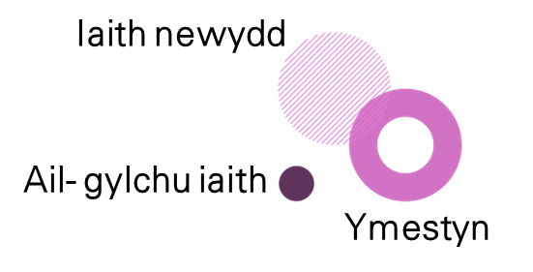
Pa iaith sydd angen nesaf? Parhau gyda’r cylch adeiladu iaith ar ôl ymarfer y patrymau iaith.
Symud at gam 2

